Slide 1
Hexagonal Architectures
Ports and Adapters

Slide 2
Who are you?
Software Developer for 20 years
Worked mainly for ISVs
Reuters, SunGard, Misys, Huddle
Worked for a couple of MIS departments
DTI, Beazley
Microsoft MVP for C#
Interested in OO, SOA, EDA,, Messaging, REST
Interested in Agile methodologies and practices
No smart guys
Just the guys in this room

Slide 3

Intelligent collaboration for the Enterprise
The #1 SharePoint alternative in the cloud

Slide 4
Agenda
Architectural Styles
Hierarchical
Layered
Hexagonal Architectures
Implementing Hexagonal Architectures
From Application Services to Commands
Command Dispatcher
Quality of Service
Command Processor

Slide 5
Architectural Styles
From Mud to Structure

Slide 6
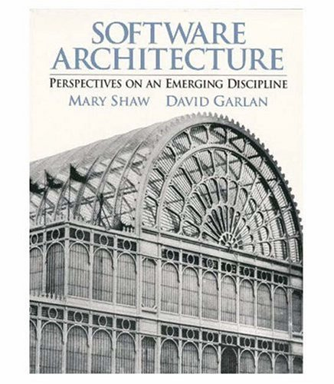
Garlan and Shaw
Working at Carnegie-Mellon in the ‘90s Shaw and Garlan begin identifying architectural styles.
Shaw and Garlan propose that the journey from craft to engineering is the creation of a body of knowledge that allows repeatable large scale production. Science provides the insights here that drive engineering.
Similar goal to the Design Patterns community – but at a different scale, capture knowledge on patterns of component interaction.

Slide 7
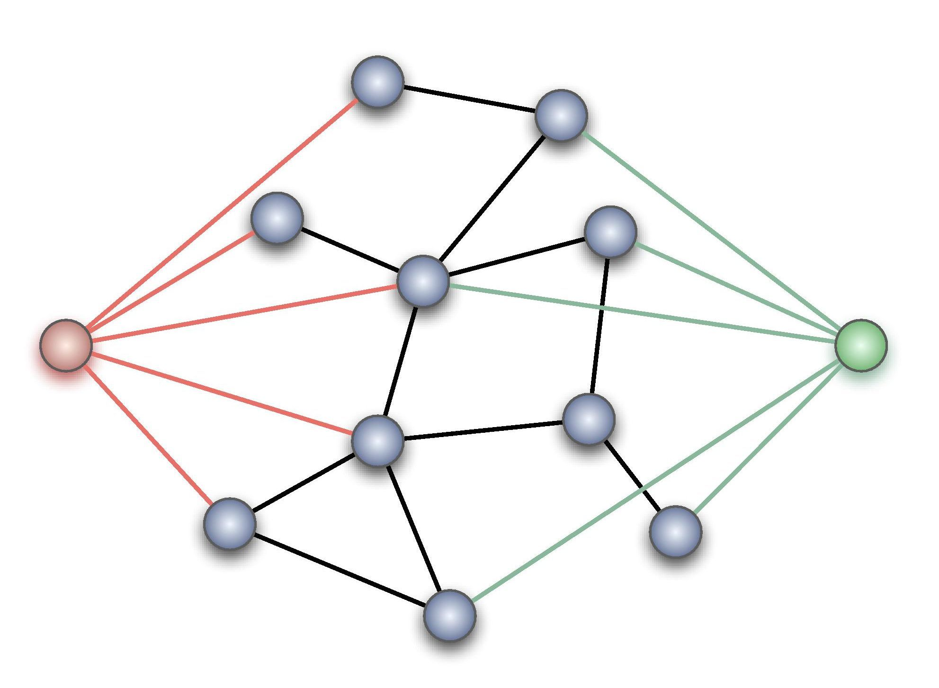
What is an architectural style?
A component is a basic architectural computational component – clients, servers, filters, layers, a database etc.
A connector provides the interaction between components.
A style is a vocabulary of possible components and connector types, and constraints on how they can be applied.
Given the above we can classify architectures:
What is the design vocabulary?
What are the allowed structural patterns?
What is the underlying computational model?
What are the essential invariants?

Slide 8
Boxology
Data Flow | Dominated by movement of data through the system, with no “upstream” content control by recipient | Pipes and Filters Batch Sequential
Data Centered | Dominated by a complex central data store manipulated by independent components | Repository Blackboards
Data Sharing | Dominated by sharing of data amongst components | Hypertext Systems Compound Document
Call & Return Systems | Dominated by order of computation, usually with a single thread of control | Procedural Object Oriented Naïve Client Server
Interacting Processes | Dominated by communication between independent, usually concurrent, processes | Event Driven (Implicit , Reactive, or Decoupled Invocation) Event Sourcing Broker SOA
Hierarchical Systems | Dominate by reduced coupling with the partition of the system into subsystems with limited interaction | Interpreters Rule-Based Systems Layers CQRS
Missing from this is obviously any discussion of User Interface styles. The question is whether MVC, for example, is simply a design pattern that fits into another one of these styles or has unique characteristics

Slide 9
Heterogeneous styles
Components
Connectors
Whilst we talk about styles in a pure form for understanding, most applications employ a combination of styles
The most common approach is hierarchical – a component identified in one style is itself implemented using another style
A single component might use different architectural connectors. A component might access a repository, but interact with other components through pipes and filters or implicit invocation
Elaborate a whole level of the architecture in a different style (as opposed to just a component)
A connector may be hierarchically decomposed as well
For example the pipe in a pipes and filters architecture might be implemented using messaging middleware, which is itself uses a heterogeneous architectural style such as repository and implicit invocation

Slide 10
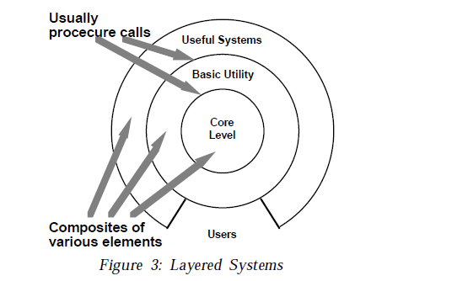
Layered Systems
Drivers
The major problem in software development is the management of complexity. Separation of concerns - the decomposition of the program into small components enables breaking a large complex system into simpler smaller ones.
Complex components may in turn require further decomposition.
Interfaces should be stable – they may even be an external contract for the system.
Changes to implementation details should not ripple through the system. Components should be replaceable with alternative implementations without affecting the rest of the system.
Similar responsibilities should have high cohesion – be grouped together – to aid reasoning about the software.
The dominant characteristic is a mix of higher and lower order operations, where high level operations depend on lower-level ones
Architectural Styles, Garlan and Shaw

Slide 11
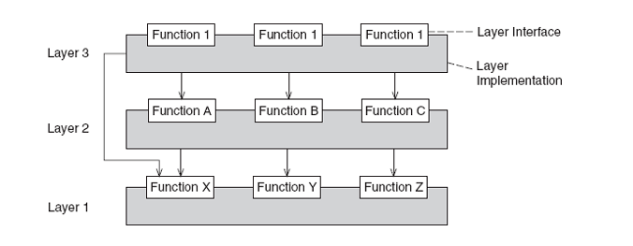
Layered Architecture
Components are the layers – a group of subtasks which implement an abstraction at some layer in the hierarchy.
Each layer provides services to the layer above it and acts as a client to the layer below.
The connectors are the protocols that define how the layers can interact.
Lower layers can pass data and service requests to higher layers via notifications (i.e. an observable)
POSA, 4th Volume

Slide 12
Invariants
Properties
Layers can only interact with adjacent layers.
A layer can provide services to a layer above, and consume services provided by the layer below.
A layer depends only on lower layers and has no knowledge of the higher layers.
The structure can be compared with a stack or onion.
Designs are based on increasing levels of abstraction. This allows portioning of a complex problem into a series of steps.
Changes to one layer impact at most two layers – below and above, supporting change.
Different implementations of the same layer can be reused interchangeably provided they support the same interface

Slide 13
Implementation
Define the abstraction criteria for grouping tasks into layers
The criteria is often the distance from the client with higher layers providing services to a user and lower levels dealing with the hardware
Determine the number of levels according to that criteria. Name those layers and assign tasks to them
Trade off between complexity of number of layers and the flexibility it provides
Again tasks that relate to the overall system as perceived by the client are in the highest layer, tasks that support that layer are in the next layer below and so on.
Specify an interface for each layer
We want to encapsulate knowledge about the layer from callers, because it supports modifiability. So we define an interface component to the layer, allowing ‘black-box’ use of that layer. This component provides a façade to the services of that layer. The black box may be ‘grey’ if we expose more than one façade component because the tasks provided by the service are orthogonal toe each other.
Specify the approach for communication between adjacent layers
Most commonly higher layers ‘push’ the data that lower levels need as part of the parameters to the call to that layer
However, sometimes a higher layer allows a lower layer to pull the information when desired, only providing a notification to the lower layer to pull on its own discretion.
If the higher layer provides notifications then the lower layer will need to use callbacks to call the higher layer, registering a subscriber with the higher layer to be notified when a change occurs.
Design an error-handling strategy
Either handle all errors within the layer or transform and pass to the higher layer
.

Slide 14
Examples
Disadvantages
Ports and Adapters (see below)
Not all systems are easily structured as layers
Performance considerations may require violation of layers and a closer coupling between higher and lower layers.

Slide 15
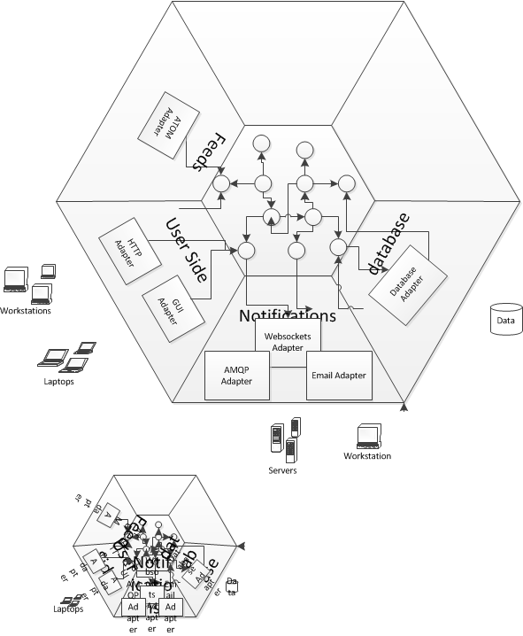
Ports and Adapters
A ports & adapters architectural style (Hexagonal Architecture) is a variation of the layered architectural style which makes clear the separation between the domain model - which contains the rules of our application - and the adapters, which abstract the inputs to the system and our outputs. The advantage of this style is that the application is decoupled from the nature of the input or output device, and any frameworks used to implement them.

Slide 16
Ports and Adapters
For example when a client POSTs a request to the REST API exposed by our application the adapter receives the HTTP request, transforms it into a call onto our domain, and marshals the response back out to the client over HTTP. Similarly if our application needs to retrieve persisted entity state to initialise the domain it calls out to an adapter that wraps access to the DB.

Slide 17
Ports and Adapters
The layer between the adapter and the domain is identified as the ports layer. Our domain is inside the port, adapters for external entities are on the outside of the port.
The notion of a 'port' invokes the OS idea that any device that adheres to a know protocol can be plugged into a port. Similarly, many adapters may use our ports.

Slide 18
Ports and Adapters
A port is the 'use case boundary'. Use cases become problematic when they become focused on technology concerns. Use cases written against the ports can elide those concerns and focus on the application rules, making them easier to write and maintain.
In BDD terms a Use Case is often expressed as Given-When-Then acceptance criteria for a story, but the principle is the same: the boundary for the GWT scenario is the ports layer.

Slide 19
Ports and Adapters
There is a correlation here between the use case boundary and the test boundary - tests should focus on the behaviour expressed by a use case, not on a unit of code.
Contrary to Cockburn, I don't suggest using a ATT like FIT or SpecFlow here, preferring to use our xUnit test tool here (and not test implementation details).

Slide 20
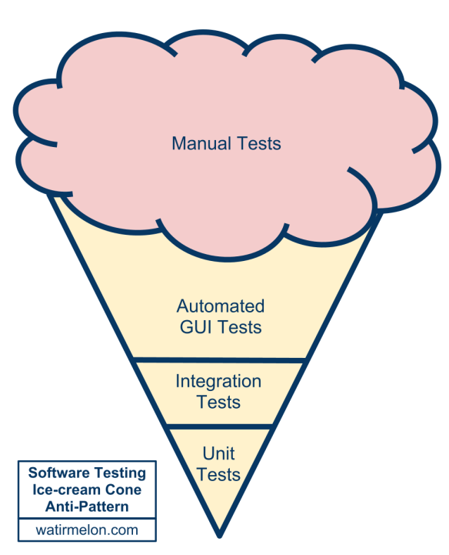
Notes:
An inverted pyramid, too much emphasis on the wrong tests.
Manual Tests
Expensive and give poor feedback. It may take days to run a manual regression pack which gives poor feedback to developers trying to determine what features caused an issue
Automated Gui Tests
Let’s skip for a moment the middle of the test automation pyramid and jump right to the top; the user interface level. Automated user interface testing is placed at the top of the test automation pyramid because we want to do as little of it as possible. We want this because user interface tests often have the following negative attributes:
* Brittle. A small change in the user interface can break many tests. When this is repeated many times over the course of a project, teams simply give up and stop correcting tests every time the user interface changes.
* Expensive to write. A quick capture-and-playback approach to recording user interface tests can work, but tests recorded this way are usually the most brittle. Writing a good user interface test that will remain useful and valid takes time.
Time consuming. Tests run through the user interface often take a long time to run. I’ve seen numerous teams with impressive suites of automated user interface tests that take so long to run they cannot be run every night, much less multiple times per day.
For much of my career test automation meant tests that drove an application through its user-interface. Such tools would often provide the facility to record an interaction with the application and then allow you to play back that interaction, checking that the application returned the same results. Such an approach works well initially. It's easy to record tests, and the tests can be recorded by people with no knowledge of programming.
But this kind of approach quickly runs into trouble, becoming an ice-cream cone. Testing through the UI like this is slow, increasing build times. Often it requires installed licences for the test automation software, which means it can only be done on particular machines. Usually these cannot easily be run in a "headless" mode, monitored by scripts to put in a proper deployment pipeline.
Most importantly such tests are very brittle. An enhancement to the system can easily end up breaking lots of such tests, which then have to be re-recorded. You can reduce this problem by abandoning record-playback tools, but that makes the tests harder to write. [1] Even with good practices on writing them, end-to-end tests are more prone to non-determinism problems, which can undermine trust in them. In short, tests that run end-to-end through the UI are: brittle, expensive to write, and time consuming to run. So the pyramid argues that you should do much more automated testing through unit tests than you should through traditional GUI based testing.
In addition, consider that in the ice-cream cone, the weight of tests is on the adapter – a component that we want to throw away to cope with technological change. If we write automation tests against our WebForms UI what happens when we decide to re-write as a SPA. The simple answer is that we are forced to throw away our tests along with the adapter!

Slide 21
UI
Integration
Unit Tests
After Mike Cohn, Martin Fowler et al.
Notes:
We want to emphasize unit tests around our domain. That is where we should strive for coverage. Divorced of technical concerns this is where we have our POCO or POJO classes, that our easy to get under test as well. We get fast feedback.
Once we have our unit tests we can figure out which parts we do not cover, usually integration with adapters and write integration tests to support them. Hopefully in many cases we are testing configuration over testing adapters directly. Don’t repeat the behavior tests from unit tests here – you should be explicitly testing integration concerns, not end-to-end behavior.
Finally we can test at the UI level (which should also really be the API level here). That allows us to test representation i.e. widgets or serialization to JSON or XML
Original models here categorized the middle layer as Services and suggested it was the place for sub-cutaneous tests that drove the behavior exposed by services. I would avoid that as I think that once you drive behaviors those are often how we drive our unit tests (with suitably mocked adapters) as it is the behavior we expose – our use case or user story. So I would treat API as just another representation concern, much as a UI. Our concerns are similar: usability etc.

Slide 22
Notes:
From Alistair Cockburn
The Pattern: Ports and Adapters (‘’Object Structural’’)
Create your application to work without either a UI or a database so you can run automated regression-tests against the application, work when the database becomes unavailable, and link applications together without any user involvement.
Alternative name: ‘’Ports & Adapters’’
Alternative name: ‘’Hexagonal Architecture’’
Intent
Allow an application to equally be driven by users, programs, automated test or batch scripts, and to be developed and tested in isolation from its eventual run-time devices and databases.
As events arrive from the outside world at a port, a technology-specific adapter converts it into a usable procedure call or message and passes it to the application. The application is blissfully ignorant of the nature of the input device. When the application has something to send out, it sends it out through a port to an adapter, which creates the appropriate signals needed by the receiving technology (human or automated). The application has a semantically sound interaction with the adapters on all sides of it, without actually knowing the nature of the things on the other side of the adapters.
Figure 1
Motivation
One of the great bugaboos of software applications over the years has been infiltration of business logic into the user interface code. The problem this causes is threefold:
First, the system can’t neatly be tested with automated test suites because part of the logic needing to be tested is dependent on oft-changing visual details such as field size and button placement;
For the exact same reason, it becomes impossible to shift from a human-driven use of the system to a batch-run system;
For still the same reason, it becomes difficult or impossible to allow the program to be driven by another program when that becomes attractive.
The attempted solution, repeated in many organizations, is to create a new layer in the architecture, with the promise that this time, really and truly, no business logic will be put into the new layer. However, having no mechanism to detect when a violation of that promise occurs, the organization finds a few years later that the new layer is cluttered with business logic and the old problem has reappeared.
Imagine now that ‘’every’’ piece of functionality the application offers were available through an API (application programmed interface) or function call. In this situation, the test or QA department can run automated test scripts against the application to detect when any new coding breaks a previously working function. The business experts can create automated test cases, before the GUI details are finalized, that tells the programmers when they have done their work correctly (and these tests become the ones run by the test department). The application can be deployed in ‘’headless’’ mode, so only the API is available, and other programs can make use of its functionality — this simplifies the overall design of complex application suites and also permits business-to-business service applications to use each other without human intervention over the web. Finally, the automated function regression tests detect any violation of the promise to keep business logic out of the presentation layer. The organization can detect, and then correct, the logic leak.
An interesting similar problem exists on what is normally considered “the other side” of the application, where the application logic gets tied to an external database or other service. When the database server goes down or undergoes significant rework or replacement, the programmers can’t work because their work is tied to the presence of the database. This causes delay costs and often bad feelings between the people.
It is not obvious that the two problems are related, but there is a symmetry between them that shows up in the nature of the solution.
Nature of the Solution
Both the user-side and the server-side problems actually are caused by the same error in design and programming — the entanglement between the business logic and the interaction with external entities. The asymmetry to exploit is not that between ‘’left’’ and ‘’right’’ sides of the application but between ‘’inside’’ and ‘’outside’’ of the application. The rule to obey is that code pertaining to the ‘’inside’’ part should not leak into the ‘’outside’’ part.
Removing any left-right or up-down asymmetry for a moment, we see that the application communicates over ‘’ports’’ to external agencies. The word “port” is supposed to evoke thoughts of ‘’ports’’ in an operating system, where any device that adheres to the protocols of a port can be plugged into it; and ‘’ports’’ on electronics gadgets, where again, any device that fits the mechanical and electrical protocols can be plugged in. The protocol for a port is given by the purpose of the conversation between the two devices. The protocol takes the form of an application program interface (API).
For each external device there is an ‘’adapter’’ that converts the API definition to the signals needed by that device and vice versa. A graphical user interface or GUI is an example of an adapter that maps the movements of a person to the API of the port. Other adapters that fit the same port are automated test harnesses such as FIT or Fitnesse, batch drivers, and any code needed for communication between applications across the enterprise or net.
On another side of the application, the application communicates with an external entity to get data. The protocol is typically a database protocol. From the application’s perspective, if the database is moved from a SQL database to a flat file or any other kind of database, the conversation across the API should not change. Additional adapters for the same port thus include an SQL adapter, a flat file adapter, and most importantly, an adapter to a “mock” database, one that sits in memory and doesn’t depend on the presence of the real database at all.
Many applications have only two ports: the user-side dialog and the database-side dialog. This gives them an asymmetric appearance, which makes it seem natural to build the application in a one-dimensional, three-, four-, or five-layer stacked architecture.
There are two problems with these drawings. First and worst, people tend not to take the “lines” in the layered drawing seriously. They let the application logic leak across the layer boundaries, causing the problems mentioned above. Secondly, there may be more than two ports to the application, so that the architecture does not fit into the one-dimensional layer drawing.
The hexagonal, or ports and adapters, architecture solves these problems by noting the symmetry in the situation: there is an application on the inside communicating over some number of ports with things on the outside. The items outside the application can be dealt with symmetrically.
The hexagon is intended to visually highlight
(a) the inside-outside asymmetry and the similar nature of ports, to get away from the one-dimensional layered picture and all that evokes, and
(b) the presence of a defined number of different ports – two, three, or four (four is most I have encountered to date).
The hexagon is not a hexagon because the number six is important, but rather to allow the people doing the drawing to have room to insert ports and adapters as they need, not being constrained by a one-dimensional layered drawing. The term ‘’hexagonal architecture’’ comes from this visual effect.
The term “port and adapters” picks up the ‘’purposes’’ of the parts of the drawing. A port identifies a purposeful conversation. There will typically be multiple adapters for any one port, for various technologies that may plug into that port. Typically, these might include a phone answering machine, a human voice, a touch-tone phone, a graphical human interface, a test harness, a batch driver, an http interface, a direct program-to-program interface, a mock (in-memory) database, a real database (perhaps different databases for development, test, and real use).
In the Application Notes, the left-right asymmetry will be brought up again. However, the primary purpose of this pattern is to focus on the inside-outside asymmetry, pretending briefly that all external items are identical from the perspective of the application.
Structure
Figure 2
Figure 2 shows an application having two active ports and several adapters for each port. The two ports are the application-controlling side and the data-retrieval side. This drawing shows that the application can be equally driven by an automated, system-level regression test suite, by a human user, by a remote http application, or by another local application. On the data side, the application can be configured to run decoupled from external databases using an in-memory oracle, or ‘’mock’’, database replacement; or it can run against the test- or run-time database. The functional specification of the application, perhaps in use cases, is made against the inner hexagon’s interface and not against any one of the external technologies that might be used.
Figure 3
Figure 3 shows the same application mapped to a three-layer architectural drawing. To simplify the drawing only two adapters are shown for each port. This drawing is intended to show how multiple adapters fit in the top and bottom layers, and the sequence in which the various adapters are used during system development. The numbered arrows show the order in which a team might develop and use the application:
With a FIT test harness driving the application and using the mock (in-memory) database substituting for the real database;
Adding a GUI to the application, still running off the mock database;
In integration testing, with automated test scripts (e.g., from Cruise Control) driving the application against a real database containing test data;
In real use, with a person using the application to access a live database.
Sample Code
The simplest application that demonstrates the ports & adapters fortunately comes with the FIT documentation. It is a simple discount computing application:
discount(amount) = amount * rate(amount);
In our adaptation, the amount will come from the user and the rate will come from a database, so there will be two ports. We implement them in stages:
With tests but with a constant rate instead of a mock database,
then with the GUI,
then with a mock database that can be swapped out for a real database.
Thanks to Gyan Sharma at IHC for providing the code for this example.
Stage 1: FIT App constant-as-mock-database
First we create the test cases as an HTML table (see the FIT documentation for this):
TestDiscounter
amount discount()
100 5
200 10
Note that the column names will become class and function names in our program. FIT contains ways to get rid of this “programmerese”, but for this article it is easier just to leave them in.
Knowing what the test data will be, we create the user-side adapter, the ColumnFixture that comes with FIT as shipped:
import fit.ColumnFixture;
public class TestDiscounter extends ColumnFixture
{
private Discounter app = new Discounter();
public double amount;
public double discount()
{ return app.discount(amount); }
}
That’s actually all there is to the adapter. So far, the tests run from the command line (see the FIT book for the path you’ll need). We used this one:
set FIT_HOME=/FIT/FitLibraryForFit15Feb2005
java -cp %FIT_HOME%/lib/javaFit1.1b.jar;%FIT_HOME%/dist/fitLibraryForFit.jar;src;bin
fit.FileRunner test/Discounter.html TestDiscount_Output.html
FIT produces an output file with colors showing us what passed (or failed, in case we made a typo somewhere along the way).
At this point the code is ready to check in, hook into Cruise Control or your automated build machine, and include in the build-and-test suite.
Stage 2: UI App constant-as-mock-database
I’m going to let you create your own UI and have it drive the Discounter application, since the code is a bit long to include here. Some of the key lines in the code are these:
...
Discounter app = new Discounter();
public void actionPerformed(ActionEvent event)
{
...
String amountStr = text1.getText();
double amount = Double.parseDouble(amountStr);
discount = app.discount(amount));
text3.setText( "" + discount );
...
At this point the application can be both demoed and regression tested. The user-side adapters are both running.
Stage 3: (FIT or UI) App mock database
To create a replaceable adapter for the database side, we create an ‘’interface’’ to a repository, a ‘’RepositoryFactory’’ that will produce either the mock database or the real service object, and the in-memory mock for the database.
public interface RateRepository
{
double getRate(double amount);
}
public class RepositoryFactory
{
public RepositoryFactory() { super(); }
public static RateRepository getMockRateRepository()
{
return new MockRateRepository();
}
}
public class MockRateRepository implements RateRepository
{
public double getRate(double amount)
{
if(amount <= 100) return 0.01;
if(amount <= 1000) return 0.02;
return 0.05;
}
}
To hook this adapter into the Discounter application, we need to update the application itself to accept a repository adapter to use, and the have the (FIT or UI) user-side adapter pass the repository to use (real or mock) into the constructor of the application itself. Here is the updated application and a FIT adapter that passes in a mock repository (the FIT adapter code to choose whether to pass in the mock or real repository’s adapter is longer without adding much new information, so I omit that version here).
import repository.RepositoryFactory;
import repository.RateRepository;
public class Discounter
{
private RateRepository rateRepository;
public Discounter(RateRepository r)
{
super();
rateRepository = r;
}
public double discount(double amount)
{
double rate = rateRepository.getRate( amount );
return amount * rate;
}
}
import app.Discounter;
import fit.ColumnFixture;
public class TestDiscounter extends ColumnFixture
{
private Discounter app =
new Discounter(RepositoryFactory.getMockRateRepository());
public double amount;
public double discount()
{
return app.discount( amount );
}
}
That concludes implementation of the simplest version of the hexagonal architecture.
Application Notes
The Left-Right Asymmetry
The ports and adapters pattern is deliberately written pretending that all ports are fundamentally similar. That pretense is useful at the architectural level. In implementation, ports and adapters show up in two flavors, which I’ll call ‘’primary’’ and ‘’secondary’’, for soon-to-be-obvious reasons. They could be also called ‘’driving’’ adapters and ‘’driven’’ adapters.
The alert reader will have noticed that in all the examples given, FIT fixtures are used on the left-side ports and mocks on the right. In the three-layer architecture, FIT sits in the top layer and the mock sits in the bottom layer.
This is related to the idea from use cases of “primary actors” and “secondary actors”. A ‘’primary actor’’ is an actor that drives the application (takes it out of quiescent state to perform one of its advertised functions). A ‘’secondary actor’’ is one that the application drives, either to get answers from or to merely notify. The distinction between ‘’primary ‘’and’’ secondary ‘’lies in who triggers or is in charge of the conversation.
The natural test adapter to substitute for a ‘’primary’’ actor is FIT, since that framework is designed to read a script and drive the application. The natural test adapter to substitute for a ‘’secondary’’ actor such as a database is a mock, since that is designed to answer queries or record events from the application.
These observations lead us to follow the system’s use case context diagram and draw the ‘’primary ports ‘’and’’ primary adapters’’ on the left side (or top) of the hexagon, and the ‘’secondary ports’’ and ‘’secondary adapters’’ on the right (or bottom) side of the hexagon.
The relationship between primary and secondary ports/adapters and their respective implementation in FIT and mocks is useful to keep in mind, but it should be used as a consequence of using the ports and adapters architecture, not to short-circuit it. The ultimate benefit of a ports and adapters implementation is the ability to run the application in a fully isolated mode.
Use Cases And The Application Boundary
It is useful to use the hexagonal architecture pattern to reinforce the preferred way of writing use cases.
A common mistake is to write use cases to contain intimate knowledge of the technology sitting outside each port. These use cases have earned a justifiably bad name in the industry for being long, hard-to-read, boring, brittle, and expensive to maintain.
Understanding the ports and adapters architecture, we can see that the use cases should generally be written at the application boundary (the inner hexagon), to specify the functions and events supported by the application, regardless of external technology. These use cases are shorter, easier to read, less expensive to maintain, and more stable over time.
How Many Ports?
What exactly a port is and isn’t is largely a matter of taste. At the one extreme, every use case could be given its own port, producing hundreds of ports for many applications. Alternatively, one could imagine merging all primary ports and all secondary ports so there are only two ports, a left side and a right side.
Neither extreme appears optimal.
The weather system described in the Known Uses has four natural ports: the weather feed, the administrator, the notified subscribers, the subscriber database. A coffee machine controller has four natural ports: the user, the database containing the recipes and prices, the dispensers, and the coin box. A hospital medication system might have three: one for the nurse, one for the prescription database, and one for the computer-controller medication dispensers.
It doesn’t appear that there is any particular damage in choosing the “wrong” number of ports, so that remains a matter of intuition. My selection tends to favor a small number, two, three or four ports, as described above and in the Known Uses.
Known Uses
Figure 4
Figure 4 shows an application with four ports and several adapters at each port. This was derived from an application that listened for alerts from the national weather service about earthquakes, tornadoes, fires and floods, and notified people on their telephones or telephone answering machines. At the time we discussed this system, the system’s interfaces were identified and discussed by ‘’technology, linked to purpose’’. There was an interface for trigger-data arriving over a wire feed, one for notification data to be sent to answering machines, an administrative interface implemented in a GUI, and a database interface to get their subscriber data.
The people were struggling because they needed to add an http interface from the weather service, an email interface to their subscribers, and they had to find a way to bundle and unbundle their growing application suite for different customer purchasing preferences. They feared they were staring at a maintenance and testing nightmare as they had to implement, test and maintain separate versions for all combinations and permutations.
Their shift in design was to architect the system’s interfaces ‘’by purpose’’ rather than by technology, and to have the technologies be substitutable (on all sides) by adapters. They immediately picked up the ability to include the http feed and the email notification (the new adapters are shown in the drawing with dashed lines). By making each application executable in headless mode through APIs, they could add an app-to-add adapter and unbundle the application suite, connecting the sub-applications on demand. Finally, by making each application executable completely in isolation, with test and mock adapters in place, they gained the ability to regression test their applications with stand-alone automated test scripts.
Mac, Windows, Google, Flickr, Web 2.0
In the early 1990s, MacIntosh applications such as word processor applications were required to have API-drivable interfaces, so that applications and user-written scripts could access all the functions of the applications. Windows desktop applications have evolved the same ability (I don’t have the historical knowledge to say which came first, nor is that relevant to the point).
The current (2005) trend in web applications is to publish an API and let other web applications access those APIs directly. Thus, it is possible to publish local crime data over a Google map, or create web applications that include Flickr’s photo archiving and annotating abilities.
All of these examples are about making the ‘’primary ‘’ports’ APIs visible. We see no information here about the secondary ports.
Stored Outputs
This example written by Willem Bogaerts on the C2 wiki:
“I encountered something similar, but mainly because my application layer had a strong tendency to become a telephone switchboard that managed things it should not do. My application generated output, showed it to the user and then had some possibility to store it as well. My main problem was that you did not need to store it always. So my application generated output, had to buffer it and present it to the user. Then, when the user decided that he wanted to store the output, the application retrieved the buffer and stored it for real.
I did not like this at all. Then I came up with a solution: Have a presentation control with storage facilities. Now the application no longer channels the output in different directions, but it simply outputs it to the presentation control. It’s the presentation control that buffers the answer and gives the user the possibility to store it.
The traditional layered architecture stresses “UI” and “storage” to be different. The Ports and Adapters Architecture can reduce output to being simply “output” again. ”
Anonymous example from the C2-wiki
“In one project I worked on, we used the SystemMetaphor of a component stereo system. Each component has defined interfaces, each of which has a specific purpose. We can then connect components together in almost unlimited ways using simple cables and adapters.”
Distributed, Large-Team Development
This one is still in trial use and so does not properly count as a use of the pattern. However, it is interesting to consider.
Teams in different locations all build to the Hexagonal architecture, using FIT and mocks so the applications or components can be tested in standalone mode. The CruiseControl build runs every half hour and runs all the applications using the FIT+mock combination. As application subsystem and databases get completed, the mocks are replaced with test databases.
Separating Development of UI and Application Logic
This one is still in early trial use and so does not count as a use of the pattern. However, it is interesting to consider.
The UI design is unstable, as they haven’t decided on a driving technology or a metaphor yet. The back-end services architecture hasn’t been decided, and in fact will probably change several times over the next six months. Nonetheless, the project has officially started and time is ticking by.
The application team creates FIT tests and mocks to isolate their application, and creates testable, demonstrable functionality to show their users. When the UI and back-end services decisions finally get met, it “should be straightforward” to add those elements the application. Stay tuned to learn how this works out (or try it yourself and write me to let me know).
Related Patterns
Adapter
The ‘’Design Patterns’’ book contains a description of the generic ‘’Adapter’’ pattern: “Convert the interface of a class into another interace clients expect.” The ports-and-adapters pattern is a particular use of the ‘’Adapter’’ pattern.
Model-View-Controller
The MVC pattern was implemented as early as 1974 in the Smalltalk project. It has been given, over the years, many variations, such as Model-Interactor and Model-View-Presenter. Each of these implements the idea of ports-and-adapters on the primary ports, not the secondary ports.
Mock Objects and Loopback
“A mock object is a “double agent” used to test the behaviour of other objects. First, a mock object acts as a faux implementation of an interface or class that mimics the external behaviour of a true implementation. Second, a mock object observes how other objects interact with its methods and compares actual behaviour with preset expectations. When a discrepancy occurs, a mock object can interrupt the test and report the anomaly. If the discrepancy cannot be noted during the test, a verification method called by the tester ensures that all expectations have been met or failures reported.” — From http://MockObjects.com
Fully implemented according to the mock-object agenda, mock objects are used throughout an application, not just at the external interface The primary thrust of the mock object movement is conformance to specified protocol at the individual class and object level. I borrow their word “mock” as the best short description of an in-memory substitute for an external secondary actor.
The Loopback pattern is an explicit pattern for creating an internal replacement for an external device.
Pedestals
In “Patterns for Generating a Layered Architecture”, Barry Rubel describes a pattern about creating an axis of symmetry in control software that is very similar to ports and adapters. The ‘’Pedestal’’ pattern calls for implementing an object representing each hardware device within the system, and linking those objects together in a control layer. The ‘’Pedestal’’ pattern can be used to describe either side of the hexagonal architecture, but does not yet stress the similarity across adapters. Also, being written for a mechanical control environment, it is not so easy to see how to apply the pattern to IT applications.
Checks
Ward Cunningham’s pattern language for detecting and handling user input errors, is good for error handling across the inner hexagon boundaries.
Dependency Inversion (Dependency Injection) and SPRING
Bob Martin’s Dependency Inversion Principle (also called Dependency Injection by Martin Fowler) states that “High-level modules should not depend on low-level modules. Both should depend on abstractions. Abstractions should not depend on details. Details should depend on abstractions.” The ‘’Dependency Injection ‘’pattern by Martin Fowler gives some implementations. These show how to create swappable secondary actor adapters. The code can be typed in directly, as done in the sample code in the article, or using configuration files and having the SPRING framework generate the equivalent code.
Acknowledgements
Thanks to Gyan Sharma at Intermountain Health Care for providing the sample code used here. Thanks to Rebecca Wirfs-Brock for her book ‘’Object Design’’, which when read together with the ‘’Adapter’’ pattern from the ‘’Design Patterns’’ book, helped me to understand what the hexagon was about. Thanks also to the people on Ward’s wiki, who provided comments about this pattern over the years (e.g., particularly Kevin Rutherford’s http://silkandspinach.net/blog/2004/07/hexagonal_soup.html).

Slide 23
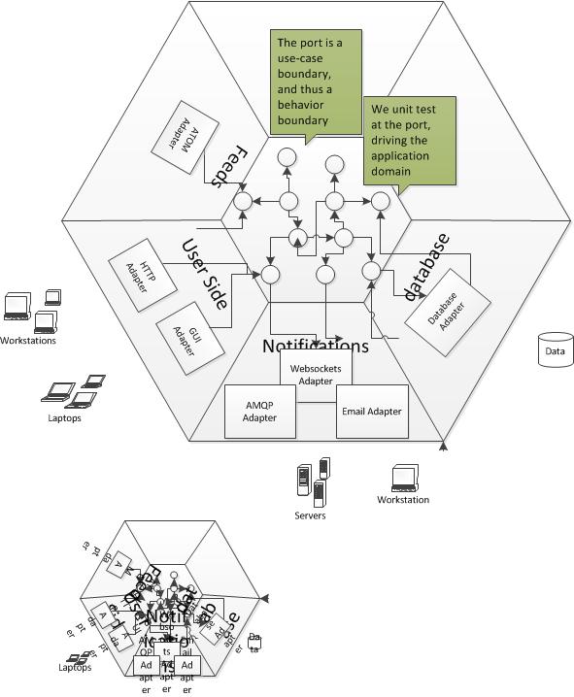
Notes:
Unit tests exercise individual objects or value types or small clusters of objects within in a single process. In particular, when doing Test-Driven Development, unit tests exercise code that we can change in response to the feedback we get from writing the tests.
Acceptance tests are customer-facing tests that capture the domain logic the system must perform and demonstrates that it performs them.
The Ports & Adapters architecture makes it possible to run acceptance-tests directly against the application domain model because the domain model is cleanly decoupled from the technical infrastructure that connects it to the outside world. Acceptance tests can interact with the domain model through its port interfaces. Acceptance tests written against an isolated domain model can run extremely fast. Because there is no persistent state involved, in databases or message queues for example, it is easy to isolate tests from one another.
Acceptance tests of a distributed system can instantiate the domain models of different processes in the same memory space and link them by implementations of their port interfaces that do not go out-of-process.

Slide 24
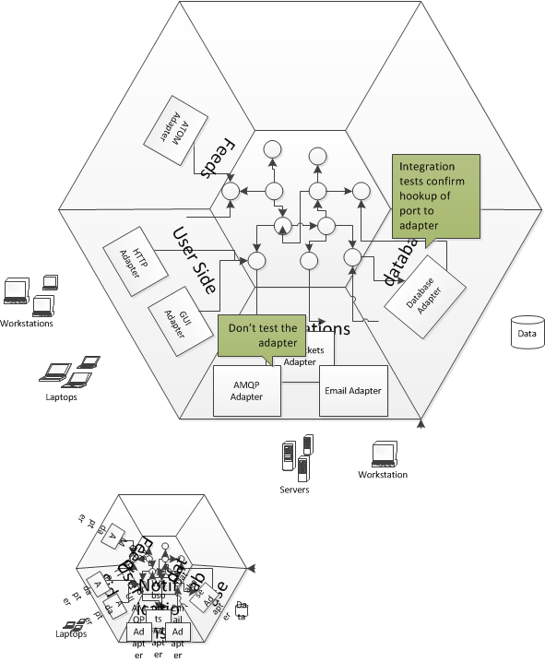
Notes:
The term "integration test" can apply to many different kinds of test. In the book, we use the term specifically to mean the test of an abstraction that we own but have implemented with some third-party package. We want to test that our code implementing the abstraction integrates with that third-party package correctly: that we have not made any incorrect assumptions about how it works or tripped over any bugs that we will have to work around. However, we cannot respond to feedback the tests give us about the internal quality of that third-party package because we cannot change it.

Slide 25
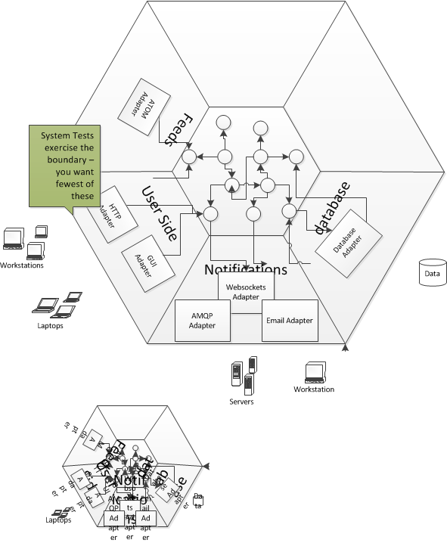

Slide 26
Ports and Adapters
We have a notion of primary and secondary actors in use cases which map to the adapter and port layer.
Primary actors exercise our application, they are inputs into our application. A primary actor uses a primary adapter, which calls a primary port - the chain is one of inputs into our application. So our REST API is a primary adapter, so are our tests.
A secondary actor is one that our application exercises as part of its work, they are outputs from out application. So our DB is a secondary adapter, as our mocks and we talk to them over a secondary port.
Many applications seem to consist only of one primary and one secondary, which leads to the n-tier style, but once we factor in tests we may begin to observe that we have more, and by building for multiple ports we make our application more modifiable to new ports in future.
We often show primary ports on the left and secondary ports on the right.

Slide 27
Implementing ports
Domain and adapter are obvious, but what are ports?

Slide 28
Implementing Ports
Service Facade
A Facade used in this context is being used in the Service role, where the Service stereotype describes an object that provides co-ordination and control logic. It provides a contract to clients for lower layers.
One question is, how is our API provided? We are inside an adapter, so we want to use a Plain Old C# Object (POCO) approach to avoid framework dependencies. A common route is to use the Facade pattern, providing a class that holds the API to lower level components. Indeed this is the classical implementation strategy for the application service layer in an layered architecture. The Facade design pattern provides a high-level interface to a sub-system, shielding the caller from the implementation details of the sub-system. This both reduces complexity for the caller, and decouples the caller from the implementation allowing us to vary it without amending the caller. To this extent it meets the needs of our port, providing a clear notion of outside - the caller and inside - the subsystem.
public class MyFatService
{
public void CreateMyThing(/* .. parameters ...*/)
{
/*Stuff*/
}
public void UpdateMyThingForFoo(/* .. parameters ...*/)
{
/*Other Stuff*/
}
public void UpdateMyThingForBar(/* .. parameters ...*/)
{
/*Other Stuff*/
}
/*Loads more of these*/
}
<code/>

Slide 29
Interface Segregation Principle
public interface ICreateMyThingService
{
void CreateMyThing(/* .. parameters ...*/);
}
public interface IUpdateMyThingForFooService
{
void UpdateMyThingForFoo(/* .. parameters ...*/);
}
public interface IUpdateMyThingForBarService
{
void UpdateMyThingForBar(/* .. parameters ...*/);
}
public class MyFatService : ICreateMyThingService, IUpdateMyThingForFooService, IUpdateMyThingForBarService
{
public void CreateMyThing(/* .. parameters ...*/)
{
/*Stuff*/
}
public void UpdateMyThingForFoo(/* .. parameters ...*/)
{
/*Other Stuff*/
}
public void UpdateMyThingForBar(/* .. parameters ...*/)
{
/*Other Stuff*/
}
/*Loads more of these*/
}
The Interface Segregation Principle states that clients should not be forced to depend on methods on an interface that they do not use. This is because we do not want to update the client because the interface changes to service other clients in a way that the client itself does not care about. An Transaction Script style port forces consumers (for example MVC controllers) to become dependent on methods on the domain service class that they do not consume.
Now this can be obviated by having the domain service implement a number of interfaces, and hand to its clients interfaces that only cover the concerns they have. With application service layers this naturally tends towards one method per interface.

Slide 30
Single Responsibility Principle
public interface ICreateMyThingService
{
void CreateMyThing(/* .. parameters ...*/);
}
public class CreateMyThingService : ICreateMyThingService
{
public void CreateMyThing(/* .. parameters ...*/)
{
/*Stuff */
}
}
public interface IUpdateMyThingForFooService
{
void UpdateMyThingForFoo(/* .. parameters ...*/);
}
public class UpdateMyThingForFooService : IUpdateMyThingForBarService
{
public void UpdateMyThingForBar(/* .. parameters ...*/)
{
/*Other Stuff*/
}
}
public interface IUpdateMyThingForFooService
{
void UpdateMyThingForBar(/* .. parameters ...*/);
}
public class UpdateMyThingForFooService : IUpdateMyThingForFooService
{
public void UpdateMyThingForFoo(/* .. parameters ...*/)
{
/*Other Stuff*/
}
}
Now the Single Responsibility Principle suggests that a class should have one and only one reason to change. All these separate interfaces begin to suggest that a separate class might be better for each interface, to avoid updating a class for concerns that it does not have. So we tend to move toward one class per API endpoint.

Slide 31
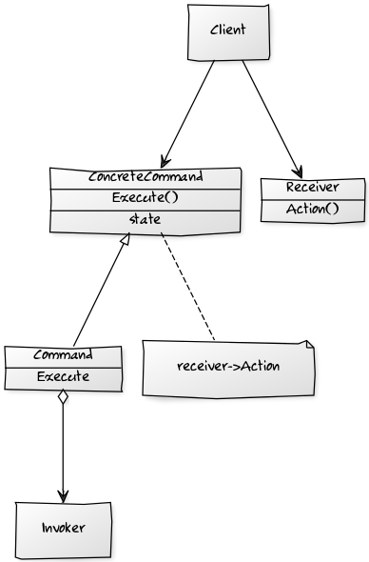
Command Design Pattern
The command design pattern encapsulates a request as an object, allowing reuse, queuing or logging of requests, or undoable operations.
It also serves to decouple the implementation of the request from the requestor. The caller of a command object does not need to understand how the command is actioned, only that the command exists. When the caller and the implementer are decoupled it becomes easy to replace or refactor the implementation of the request, without impacting the caller - our system is more modifiable. Our ability to test the command in isolation of the caller - allows us to implement the ports and adapters model easily - we can instantiate the command, provide 'fake' parameters to it and confirm the results. We can also use the command from multiple callers, although this is not a differentiator from the service class approach.
Command - Declares an interface for executing an operation.
ConcreteCommand –Defines a binding between a Receiver object and an action. Implements Execute by invoking the corresponding operation(s) on Receiver.
Client – creates a ConcreteCommand object and sets its receiver.
Invoker - asks the command to carry out the request.

Slide 32
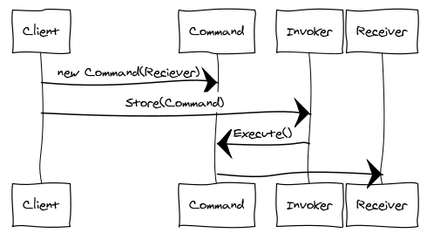
Command Sequence Diagram
An Invoker object knows about the concrete Command object.
The Invoker issues a request by calling Execute on the Command.
When commands are un-doable, the Command stores state for undoing the command prior to invoking Execute.
The Command object invokes operations on its Receiver to carry out the request

Slide 33
Command Design Pattern
In addition we can structure a system transaction ally using commands.
A command is essentially a transactional boundary.
Because a command is a transactional boundary, when using the Domain Driven Development technique of an aggregate there is a natural affinity between the command, which operates on a transactional boundary and the aggregate which is a transactional boundary within the domain model.
The aggregate is the Receiver stereotype within the Command Design pattern.
Because we want to separate use of outgoing adapters via a secondary port, such as a Repository in the DDD case, this can lead to a pattern for implementation of a command:
1: Begin Transaction
2: Load from Repository
3: Operate on Aggregate
4: Flush to Repository
5: Commit Transaction
In the Repository pattern we may need to notify other aggregates that can be eventually consistent of the change within the transaction ally consistent boundary. The pattern suggested there is a notification. Because the handling of that notification is in itself likely to be a transactional boundary for a different aggregate we can encapsulate this domain event with the Command design pattern as well, which gives rise to the following additional step to the sequence, outside the original transactional boundary:
6: Invoke Command Encapsulating Notification
Note that this is, in essence, the actor model.

Slide 34
Implementing a Command
From our perspective, the single method API endpoints are in fact commands. We could rewrite
public class UpdateMyThingForFooinService : IUpdateMyThingForFooinService
{
public void UpdateMyThingForFoo(/* .. parameters ...*/)
{
/*Other Stuff*/
}
}
using an interface to represent a command as
public interface IAmACommand
{
void Execute();
}
public class UpdateMyThingForFooFooCommand
{
public UpdateMyThingForFooCommand(/* .. parameters ...*/)
{
/* Initialize state of command for members */
}
public void Execute()
{
/*Other Stuff*/
}
}
Implementing the pattern is simple, we implement a command interface, that has a method to execute the command. We then create a concrete instance of the command that derives from this interface. The invoking class executes the command without being directly coupled to the receiver which the command uses to implement the action requested.

Slide 35
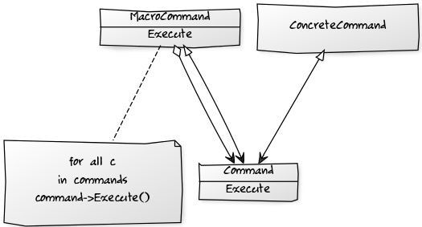
Macro Command
A Macro command is a command that consists of other commands. At its simplest form this is just a class that contains a list of commands to execute in sequence. A Macro Command has no Receiver, because each Command in the list has its own Receiver

Slide 36
Command Dispatcher
The Command Dispatcher allows dynamic registration and removal of Command Handlers, it is an administrative entity that manages linking of commands to the appropriate command handlers.
It relates to the Observer pattern in that hooks together publishers and subscribers.
Command Dispatcher registration requires a key – provided by the Command Dispatcher for the Commands it can service, using getKey(). [In practice we often use RTTI for this].
The Command Handler is fired, when a command with the same name (key) is sent to the Command Dispatcher.
The Command Dispatcher is a repository of key-value pairs (key., Command Handler) and when the Command Dispatcher is called it looks up the command’s key in the repository. If there is a match it calls the appropriate method(s) on the handler to process the Command.
To decouple a higher and lower layers we want to be able alter the implementation of the commands that we call on the lower layer without altering the calling layer.
We introduce a Command Handler for each Command that can be invoked, that all implement a specific interface. Command-handlers are registered with a Command Dispatcher (and can also be removed) at run-time.
When the application issues a command, it notifies the Command Dispatcher which dispatches to the command handler(s) associated with the command.
This decouples dispatch from processing.

Slide 37
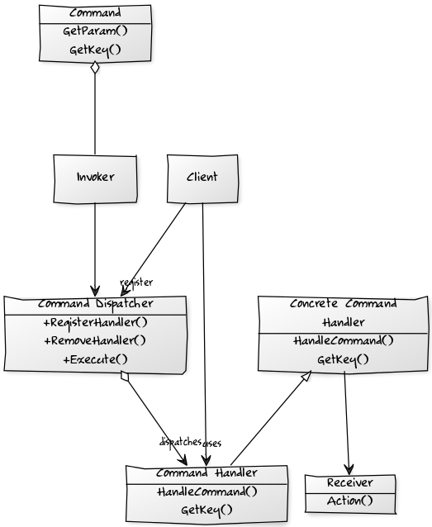
Command Dispatcher
Invoker - has a lit of Commands that are to be executed
Command - represents the request to be processed, encapsulating the parameters to be passed to the command-handler to perform the request
Command Handler - specifies the interface that any command handler must implement
Concrete Command Handler – implements the request
Command Dispatcher – Allows dynamic registration of Command Handlers and looks up handlers for commands, by matching command and handler key.
Client – registers Commands with the Command Dispatcher.

Slide 38
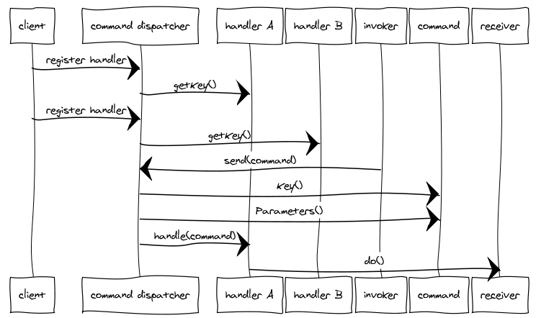
Command Dispatcher
We want to separate an Action-Request object that contains the identity of the action we want to perform, and the parameter for that action from the Action-Handler which knows how to perform that action.
A Command Dispatcher is an object that links the Action-Request with the appropriate Action-Handler.
We may distinguish between a Command Action-Request that has one Action Handler and an Event Action-Request that has many

Slide 39
Quality of Service
Controlling Service Quality at Ports

Slide 40
The Fallacies of Distributed Computing
Calls to remote components, such as a database, broker, or http service can fail. Code that makes assumption that they will succeed is subject to the fallacies of distributed computing, in particular that the network is reliable.
For this reason we need to set a limit on the time we wait for a response from the a server (or other remote resource).
Otherwise we risk tying up a thread waiting for a response that will never come, potentially causing a cascade failure where once all the resources on the machine are tied up processing requests to which no response will ever come, we cannot process new requests.
If, in turn, those requests do not have a timeout, that initial failure may now bubble to our caller, and so on…
The network is reliable.
Latency is zero.
Bandwidth is infinite.
The network is secure.
Topology doesn't change.
There is one administrator.
Transport cost is zero.
The network is homogeneous.

Slide 41
The Timeout Pattern
Timeouts have a strong correlation with the retry pattern. It may seem sensible to retry, but beware that if a resource is failing under load further retries may simply overload that resource. Consider both exponential back-off and circuit breaker strategies.
Timeouts are a scaling issue. Because an API call without a timeout consumes resources, a stalled network call, or thread, prevents other requests from being executed. You might not notice the failure to use timeouts on a system with abundant resources, but as your resources dwindle failure to use timeouts to free resources will cause pain.
Assume that a timeout will occur at some point
Asynchronous operations still need to time out. All the caller may not be blocked, resources are still being consumed to manage the asynchronous operation that will not be released until the operation aborts.
Provide a timeout on any inter-process operation.
The timeout pattern is usable with any client-server request.
The timeout pattern is also usable with thread resource pools.
Any operation that blocks a thread, should have a timeout
Usually a timeout is a parameter on an API call that indicates how long to wait [in milliseconds] for the operation to complete before returning control to the caller
If you are using a third-party API that has no timeout, you may need to make the request on a thread that does have a timeout, and when that thread times out assume that the operation failed.

Slide 42
The Retry Pattern
If the fault is permanent, and unlikely to succeed, for example a login failure due to invalid credentials – don’t retry.
If the fault is caused by a rare event, for example packet loss or other corruption, consider an immediate retry as the server may be able to respond.
If the fault is caused by load, such as SQL Timeouts, or 429 Too Many Requests, then back-off for a period before retrying. Failure to observe this can lead to an Application Denial of Service Attack i.e. we overload a struggling server.
In the case of a 429 for example, the Retry-After header will tell you how long to back off for.
In the presence of unreliable calls between two components our first approach to achieving a high quality of service is to recognize that many such failures are transient: a timeout because a resource is busy, temporary loss of connectivity, the loss of one node that will be replaced by failover to another.
In this case the fault is self-correcting, the node comes up, the load on the database or server declines and their is capacity for our call, or network connectivity is restored. This means that our call will succeed if we retry after a delay to allow the transient fault to resolve.
The Retry pattern is simply that if the call fails, we can try again. It is important to have an upper bound on retries in case a fault that appears transient is not. See Circuit Breaker as well.

Slide 43
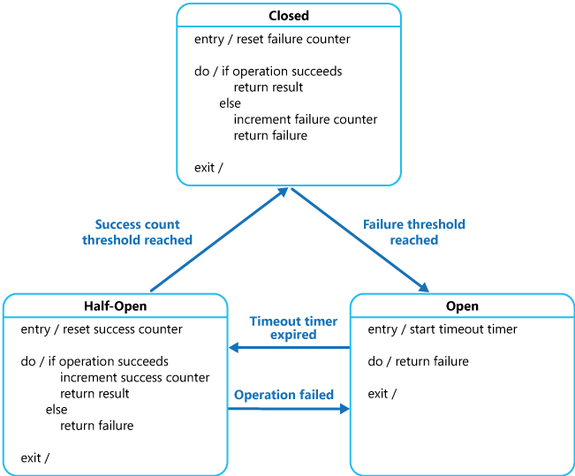
The Circuit Breaker Pattern
The Circuit Breaker pattern prevents an application from executing an operation that is likely to fail, thus freeing up resources that would otherwise be consumed waiting for a timeout and retry cycle to occur.
Once normal service has been restored to the server or resource pool the circuit breaker pattern allows detection of the resumption of service.
A Circuit Breaker acts as a proxy to operations that can fail. It has one of three states:
Closed: Requests are routed as normal, on a failure a counter is incremented and if the threshold is exceeded within a time limit, the circuit breaker opens.
Open: No calls are allowed, and are failed automatically by the proxy. After a specified time interval the circuit breaker is moved to half-open
Half-Open: A call is allowed. On a failure the breaker moves to Open, on a success it moves to Closed
From MSDN: http://msdn.microsoft.com/en-us/library/dn589784.aspx

Slide 44
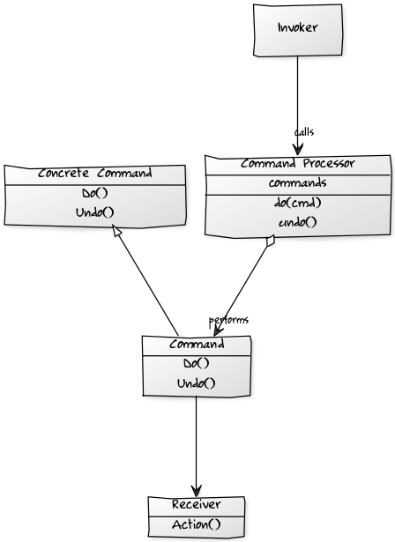
Command Processor
The Command Processor pattern separates the request for a service from its execution.
A Command Processor component manages requests as separate objects, schedules their execution, and provides additional services such as the storing of request objects for later undo.
A Command Dispatcher and a Command Processor are similar in that both divorce the caller of a Command from invoker of that Command.
However, the motivation is different. A Dispatcher seeks to decouple the caller from the invoker to allow us to easily extend the system without modification to the caller.
Conversely the motivation behind a Command Processor is to allows us to implement orthogonal operations such as logging, or scheduling without forcing the sender or receiver to be aware of them. It does this by giving those responsibilities to the invoker.

Slide 45
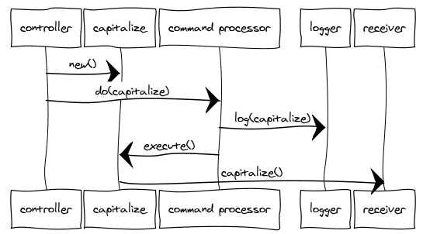
Command Processor
The Command Processor pattern provides details of how to manage a set of commands used to separate the request for service from its execution.
The Command Processor accepts requests for Commands, schedules and executes them, manages their history (such as storing for later undo or replay) and performs any other orthogonal housekeeping operations. The client is decoupled from the responsibilities of managing and scheduling commands.
A Command Processor enforces quality of service and maximizes throughput.
A Command Processor forms a juncture at which concerns like: retry, timeout and circuit breaker can be implemented for all commands.

Slide 46
Quality of Service
One option is just to bake these into the Command Processor as steps that are always performed.
Another option is to use the Open-Closed Principle to provide an interface on commands that supports these concerns that the command processor calls i.e. undo
Perhaps a better option is to merge a command processor with a command dispatcher and recognize that the Command Handler can be a batch-sequence instead of a single handler, with a sequence of steps
This sequence can be configured to run orthogonal steps by configuration, or by convention.
Classic approaches are fluent declaration and attributes. Both have trade-offs, and adherents.
By Quality of Service we mean those aspects of an application that relate to meeting the quality attributes.
Quality attributes include: maintainability, usability, security, testability, availability, performance, interoperability
Using a command processor can help us meet QoS requirements that are orthogonal to the domain, e.g.:
Logging
Retry
Timeout
Circuit Breaker
Authorization

Slide 47

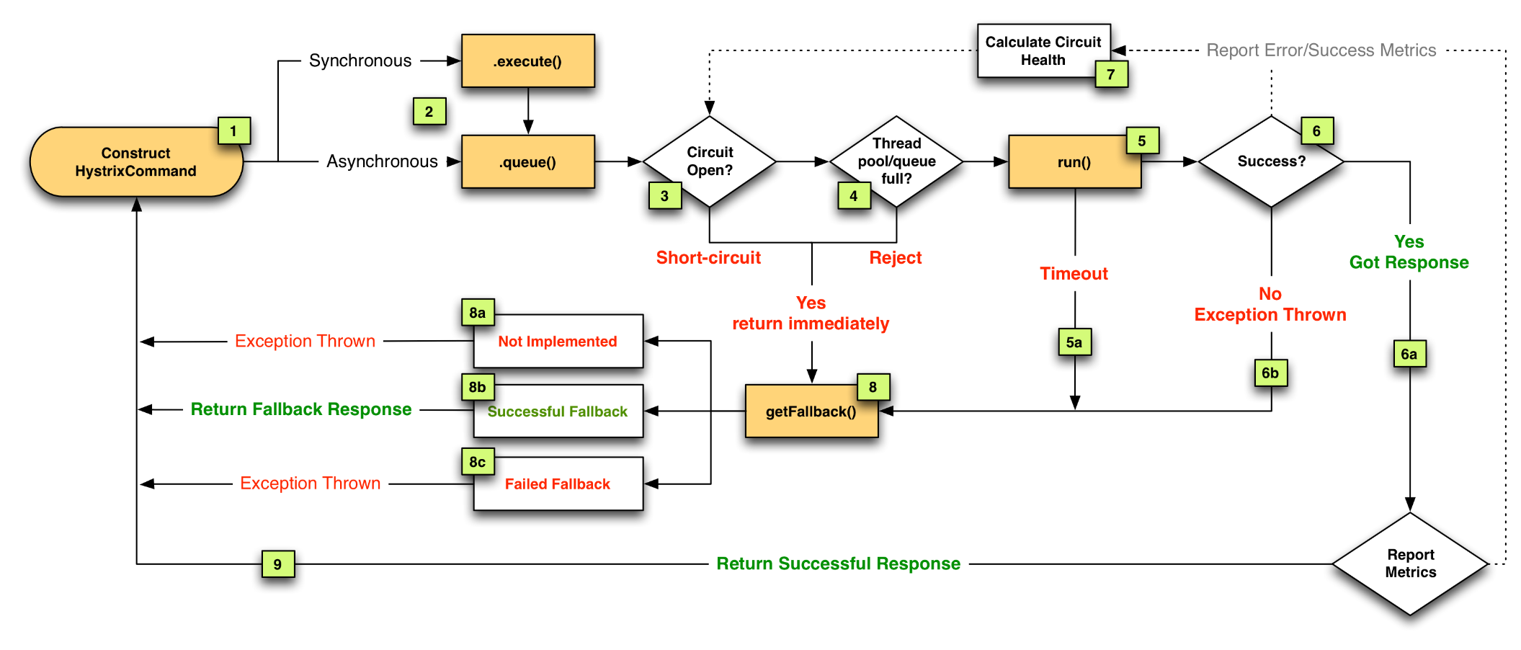
Example

Slide 48
Demo
Paramore.Brighter

